Slide 1
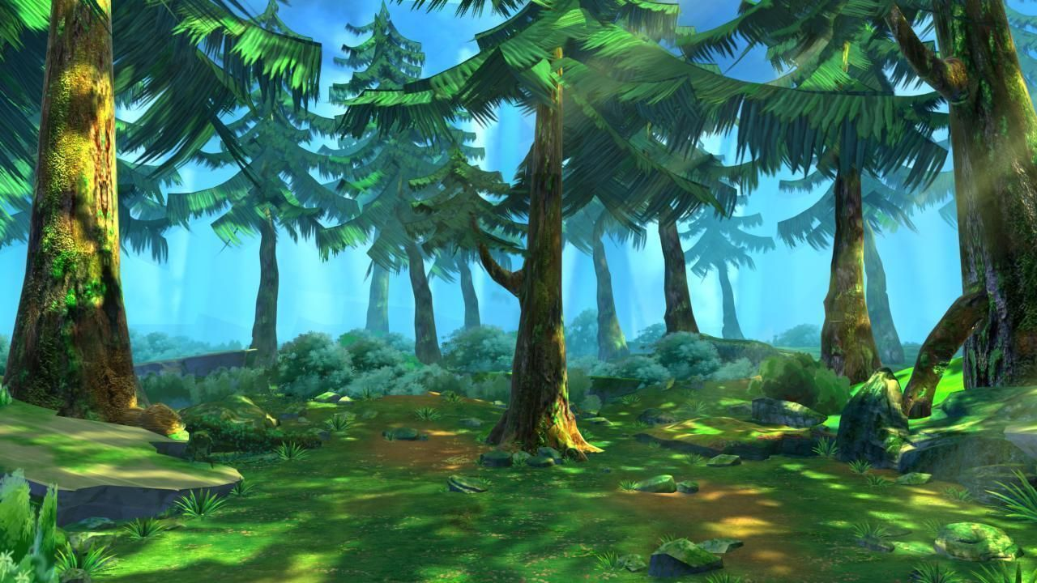


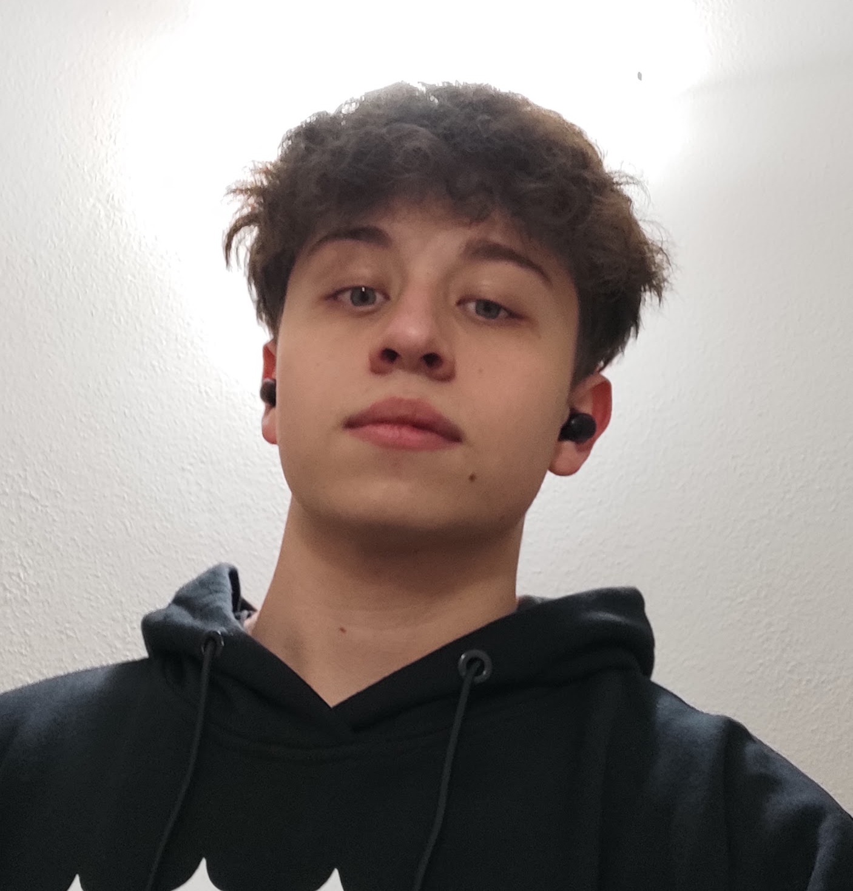
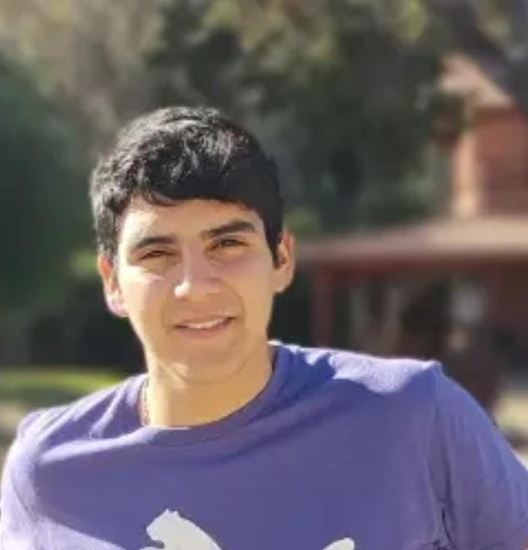

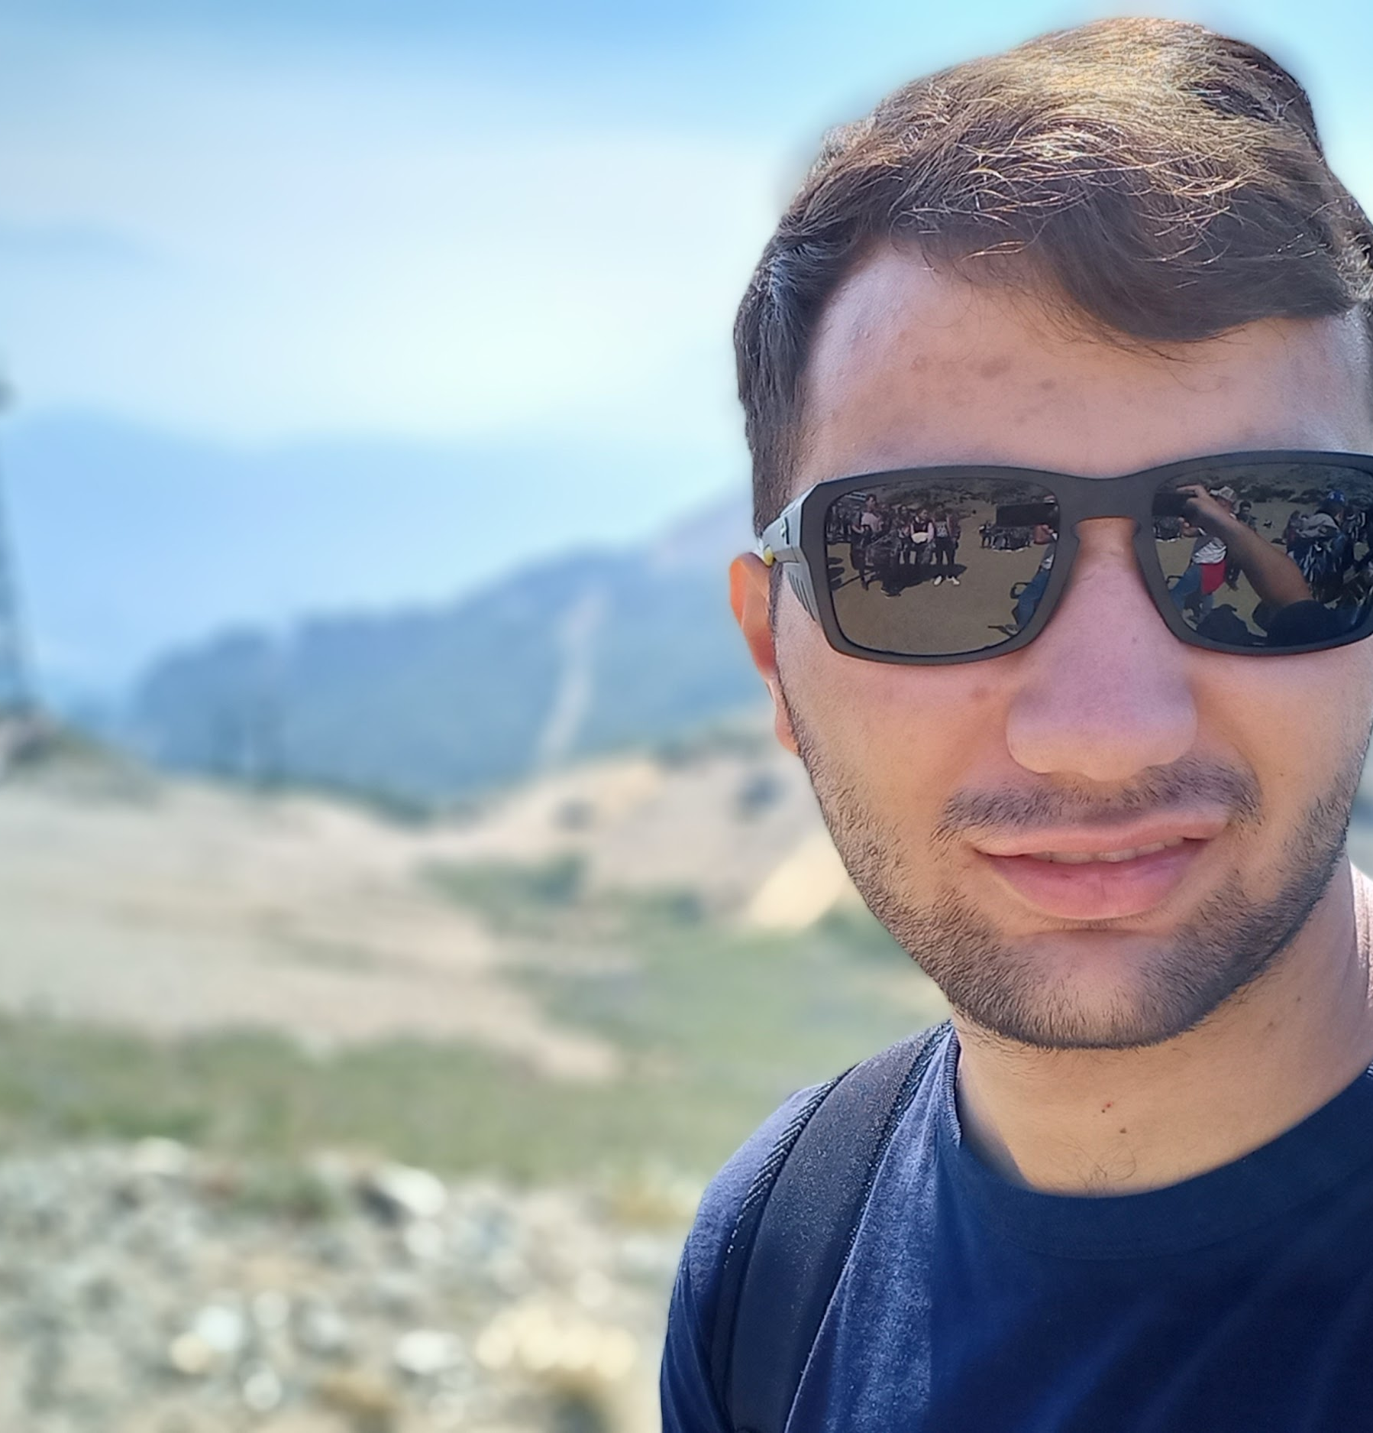

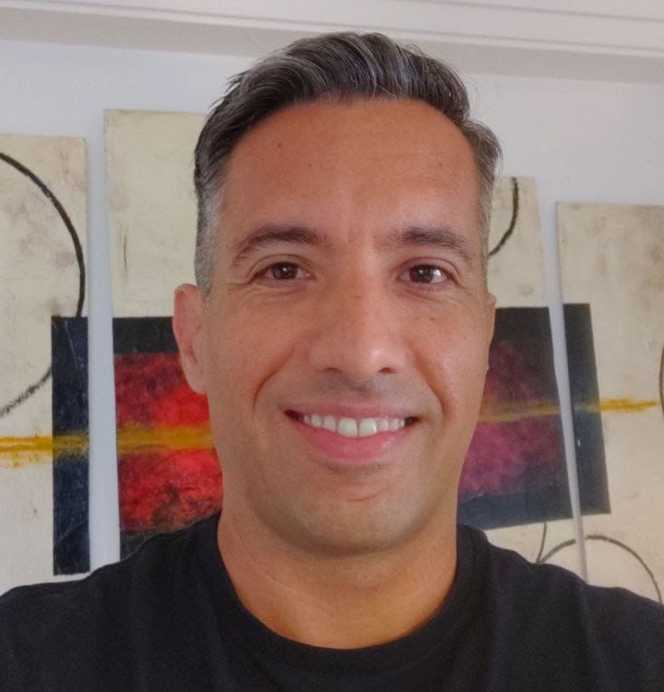
Save your land
Take flight: Making the most of NASA's airborne data challenge
AN APP TO LEARN WHILE PLAYING, RAISING AWARENESS ABOUT THE ENVIRONMENT
“Change starts from education”
San Francisco, Córdoba, Argentina
Team web site: https://bit.ly/3Sx7vgS

Slide 2
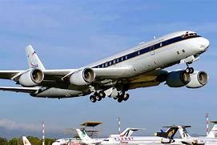
About our project
We are a group of Electronic Engineering students, and we have the help of one of our highschool teachers.
We have knowledge in programming and circuit creation.
To all of us it seemed a great opportunity to educate about a problem that affects us in the day to day.
Wildfires are a huge issue for high density area of forests and mountains.
The information obtained through NASA Airborne is of a giant didactic value.
Our goal is to educate the youth through interactive and didactic games, to form minds with environmental awareness and responsibility.

Slide 3
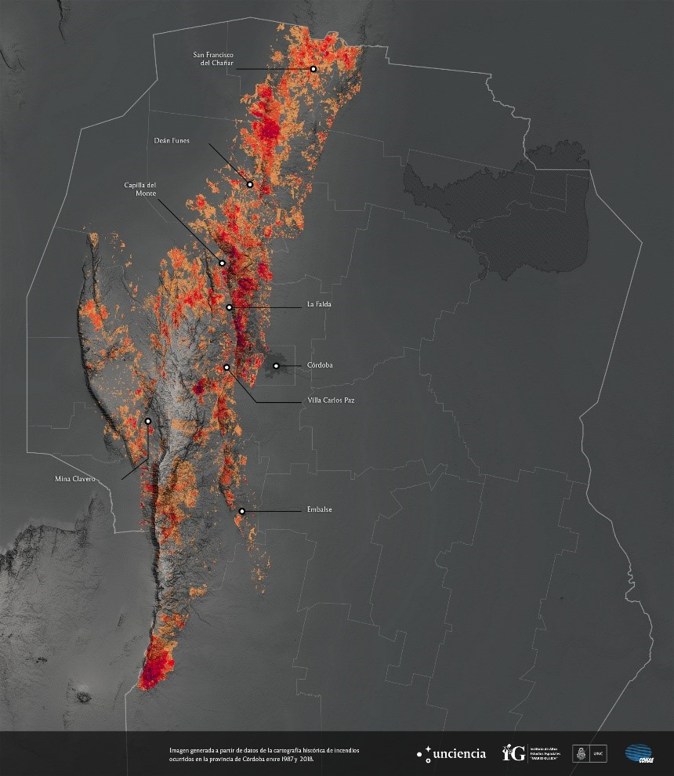
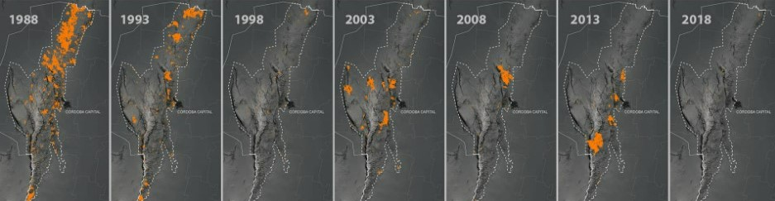
Save your land app
The information obtained by NASA, however useful, feels very distant for the average person.
For that same reason we made the game very didactic and easy to play, without forgetting to give as much useful information as possible.
To get the most out of the information we decided to make an adaptation of the FIREX-AQ data towards a local problem, using CONAE data in a complementary way.
Wildfires progress in Córdoba through years

Slide 4
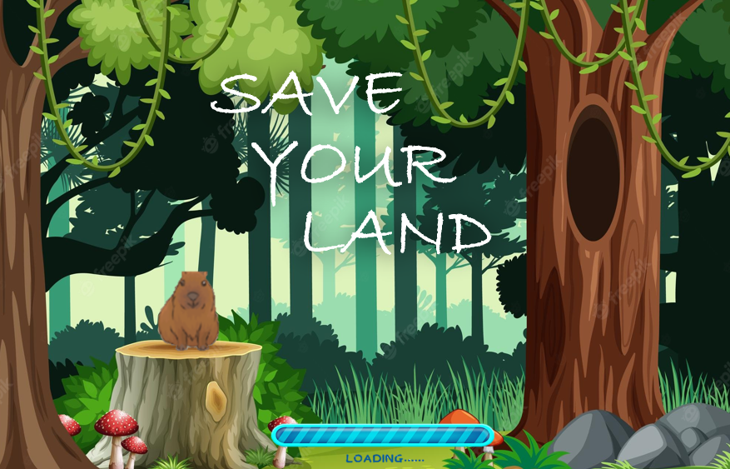
About our app
This Q&A game teaches the player through multiple challenges, such as testing their knowledge about wildfires, their effects on the environment, and local wildlife.

Slide 5
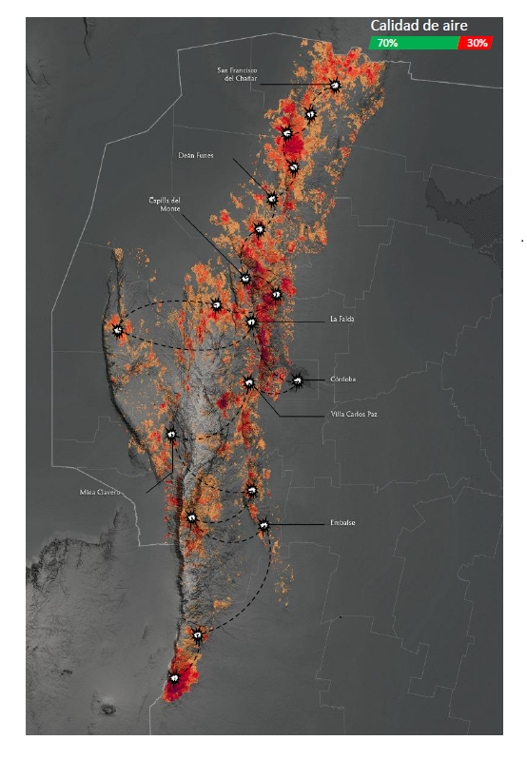
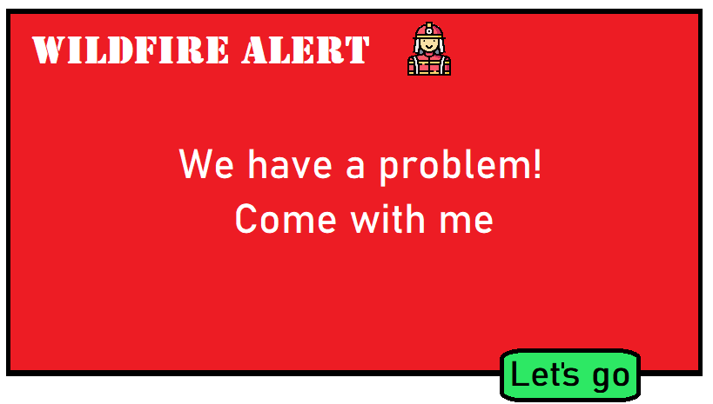
About our game
The game consists of a progress system in which the player solves certain problems to ensure that our friends, the animals, can remain in their habitats without having to suffer the consequences of wildfires. To advance in levels, different problems will occur along the way, every certain number of levels, you will advance from zone.

Slide 6
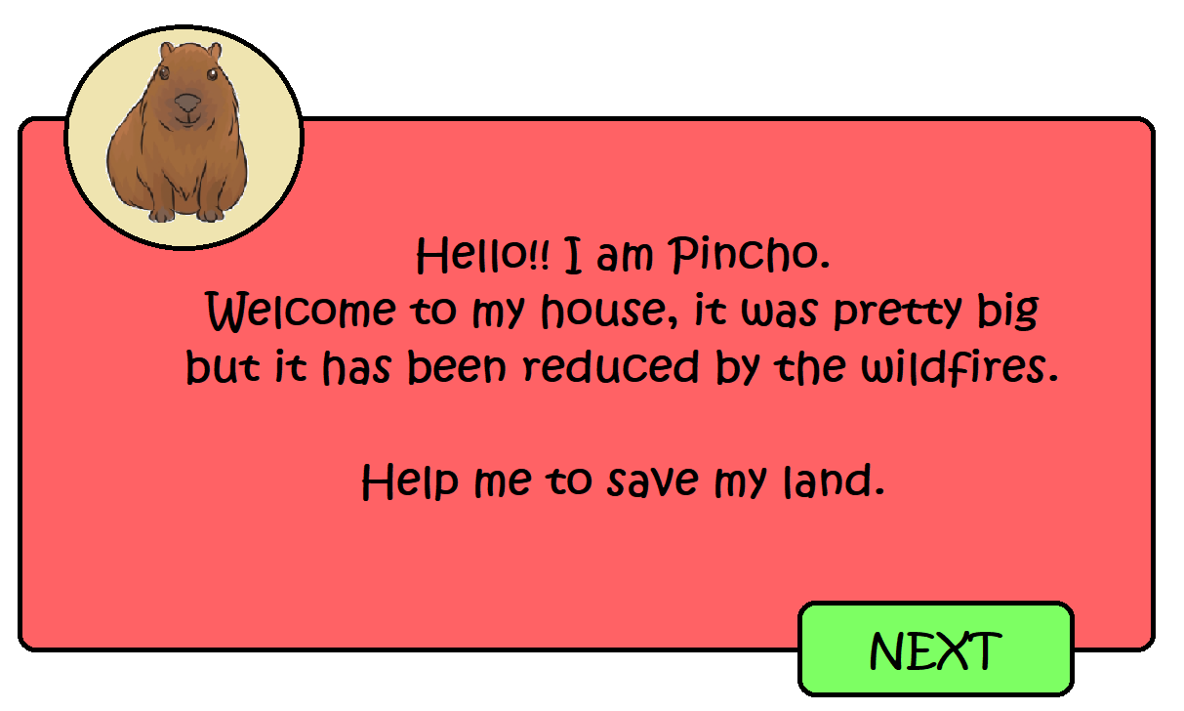
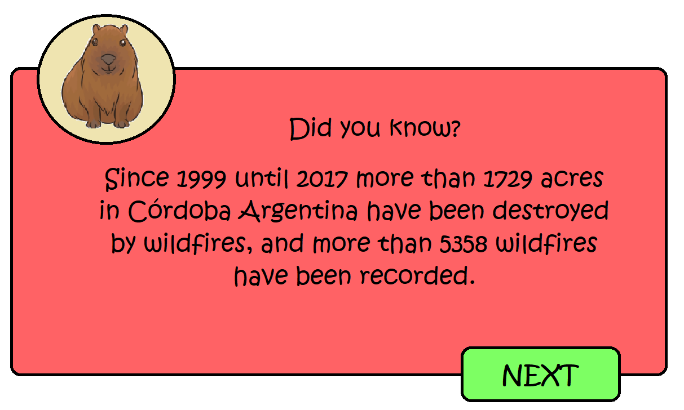
About the characters
The “friends”, will consist of different autochthonous species in danger of extinction, these characters will be in charge of giving the user a small presentation and asking for their help, later they will be the ones who will ask the questions and offer knowledge.
Some of the animals in danger of extinction that will request the user help are:
Guanaco – Chancho quimilero – Pecarí de collar – Aguará guazú – Tapetí – Carpincho – Vizcacha – Corzuela parda.

Slide 7
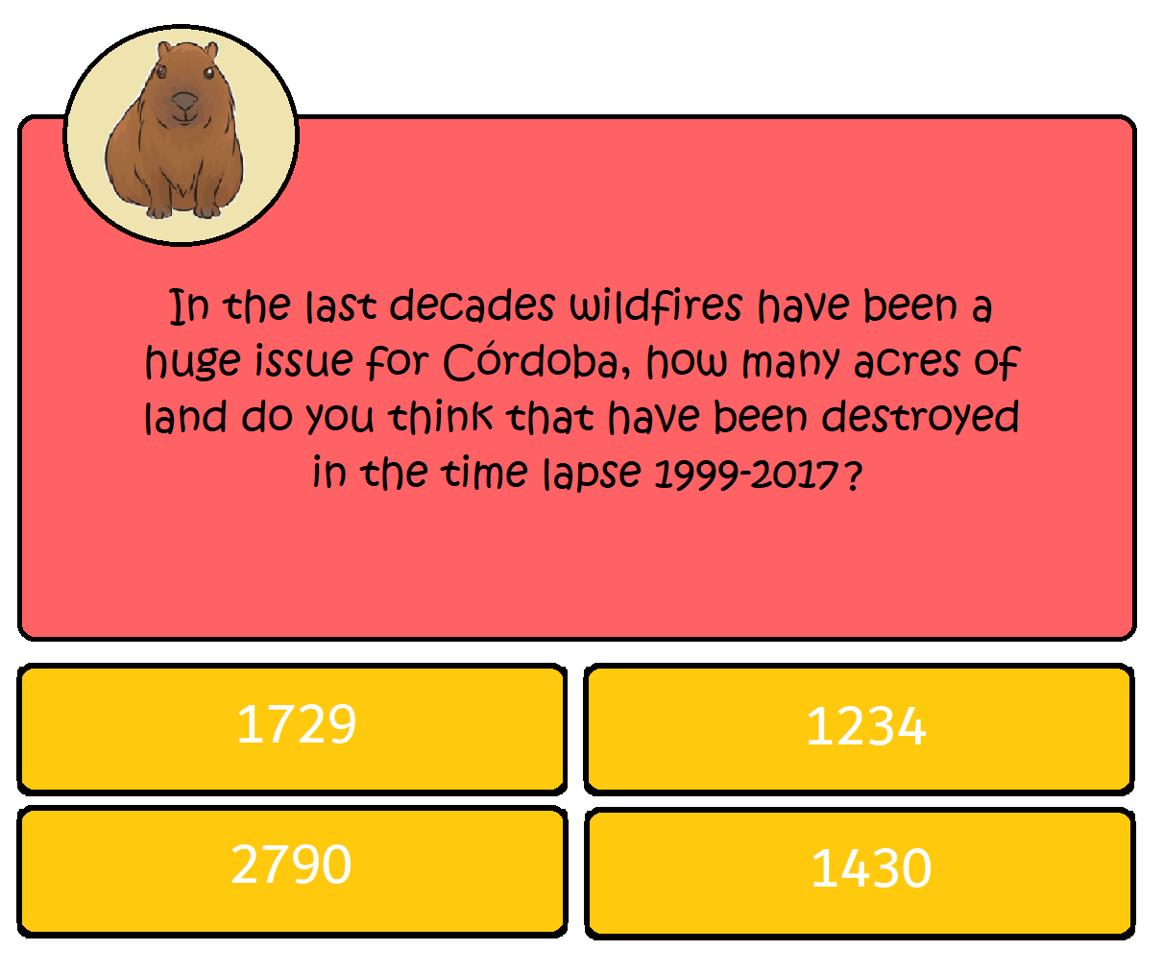
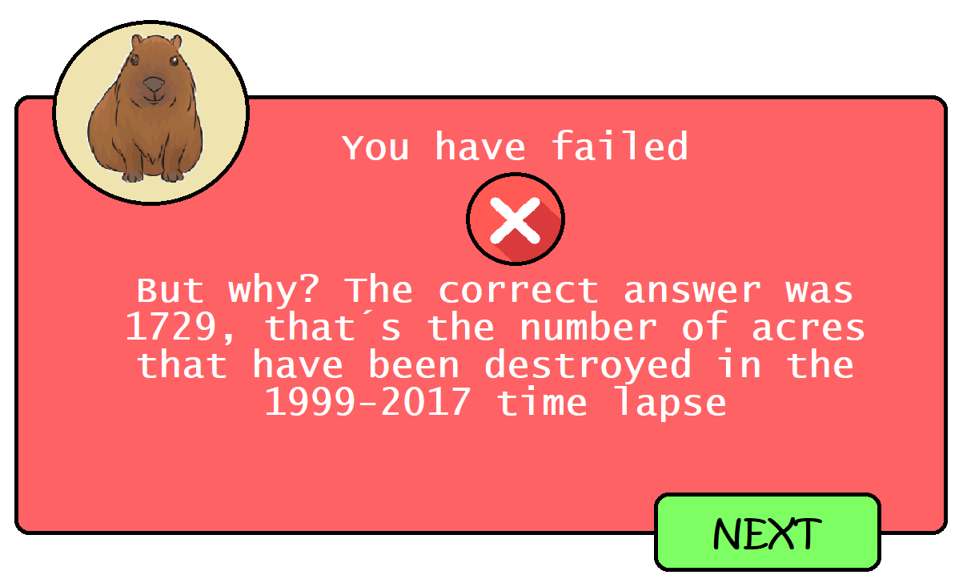
Question format
During the course of time, different alerts will occur randomly that will also be solved in the same way with which you advance level. If the questions are answered incorrectly, the air quality decreases and the player stays at the level he was before, and after this, he is shown a short video or an explanatory text showing him the mistake he made when answering, and thus feed back to the player.

